Slide 1

moose for dcs world task dispatching
a new dynamic
tasking mechanism
in joint development
with the moose
framework
community

Slide 2
task DISPATCHing
H1
GROUP1
R2
A
Dispatch Tasks to Human Players upon detection results reported by Forward Air Controllers (FAC) to Head Quarters (HQ). Tasks are Dispatched to a defined Set of Groups.
A2
C
C
SEAD
H2
B
Area 2
HQ

Slide 3
A2G task DISPATCHing using DETECTION_AREAS
H1
GROUP1
R2
A
Dispatch Tasks to Human Players upon detection results reported by Forward Air Controllers (FAC) to Head Quarters (HQ). Tasks are Dispatched to defined Set of Groups.
A2
C
C
SEAD
H2
B
Area 2
HQ

Slide 4
(1) fac detect targets using DETECTION_AREAS
2 FACs R1 and R2 are detecting targets.
R1 detects A and B, and defines an Area 1.
R2 detects C and D, and defines an Area 2 and 3.
2 Attack Helicopters H1 and H2 are airborne, awaiting orders.
A
Area 1
R1
B
A
H1
R2
Area 3
A
D
C
H2
A
Area 2

Slide 5
(2) fac reports detected targets to hq
R1 reports Area 1 to HQ.
R2 reports Area 2 and Area 3 to HQ.
A
Area 1
R1
B
A
H1
R2
Area 3
A
A1
A
B
A2
A3
D
C
D
C
H2
A
Area 2
HQ

Slide 6
(3) hq dispatches TASKS TO player groups
HQ defines CAS, SEAD and BAI tasks, and communicate them to GROUP1 and GROUP2.
A
Area 1
HQ defines a CAS for A1 because of nearby friendlies.
R1
B
P1
A
C
GROUP2
H1
GROUP1
R2
Area 3
HQ defines BAI tasks for A2 and A2 because there are no friendlies.
A
A1
Planned
A
B
D
CAS
A2
C
SEAD
C
H2
BAI
A3
B
D
HQ defines SEAD task(s) because of RADAR presence.
HQ
Area 2

Slide 7
(4) player GROUPS select tasks and engage
E
GROUP 1 selects the CAS and BAI tasks.
GROUP 2 selects the SEAD tasks.
A
AREA 1
R1
B
P1
A
C
GROUP2
H1
GROUP1
R2
AREA 3
A
SEAD
Assigned
CAS
D
Assigned
C
H2
BAI
B
Planned
AREA 2
HQ

Slide 8
INTERFACE DURING BATTLE

Slide 9
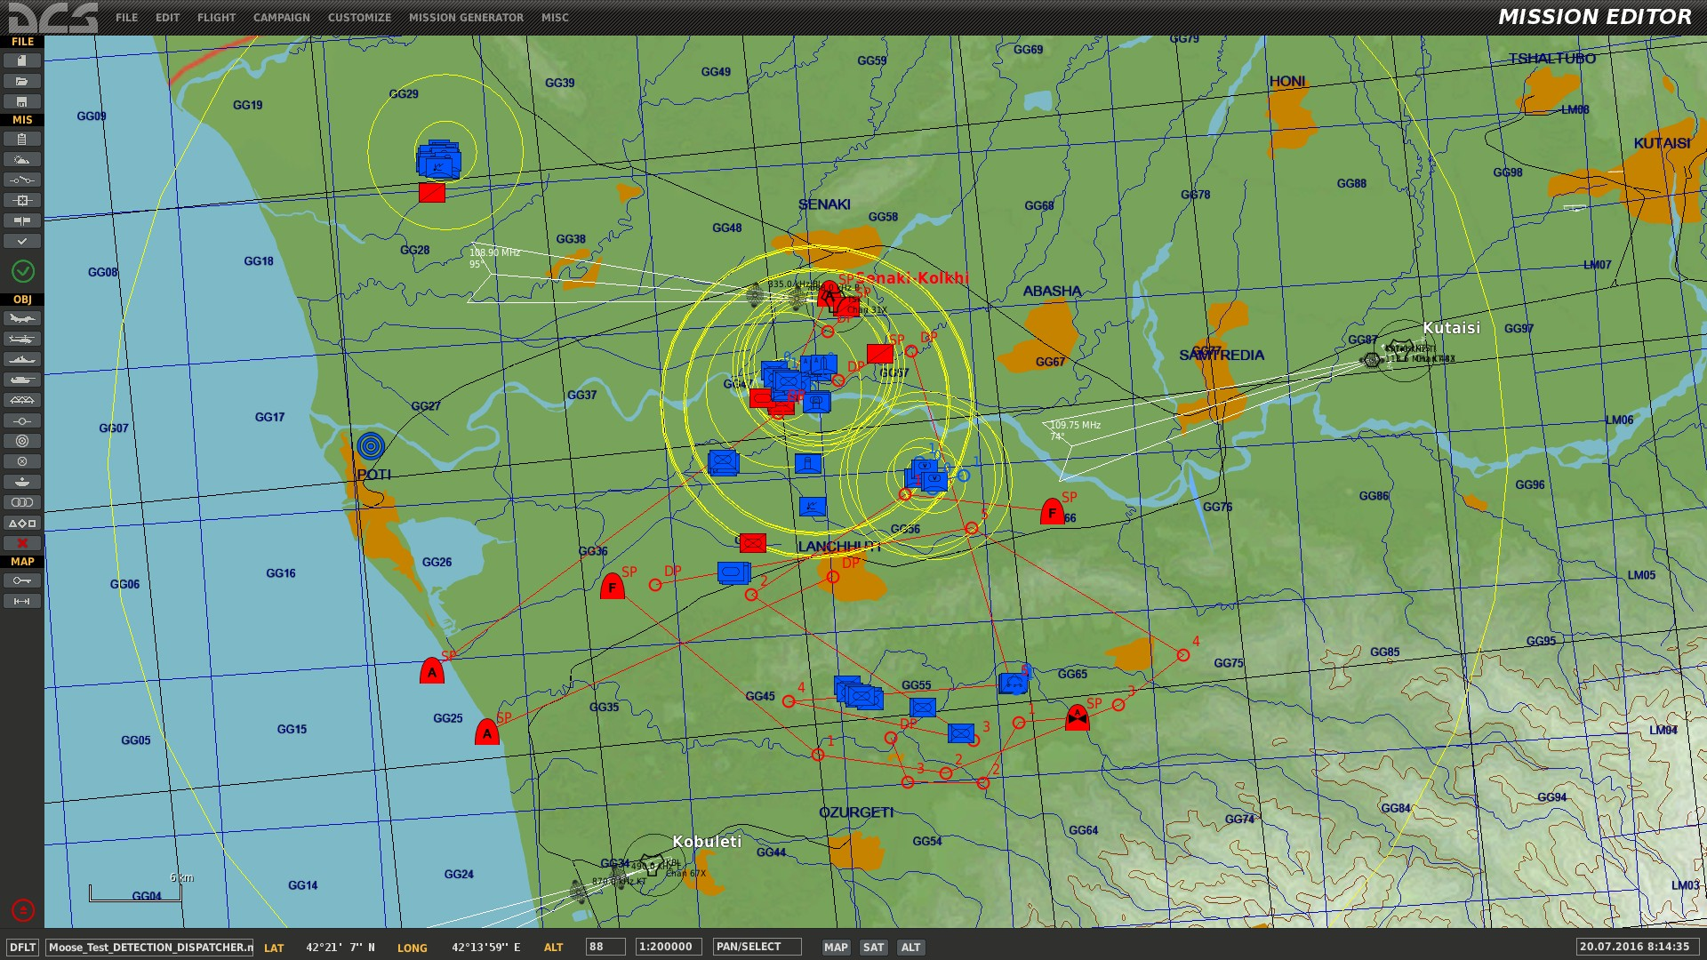
battle scene overview
1
Red against blue
1
2
Red ground FACs detecting blue targets
4
3
Red AFACs detecting blue targets
2
4
3 red attack GROUPS
3
4

Slide 10
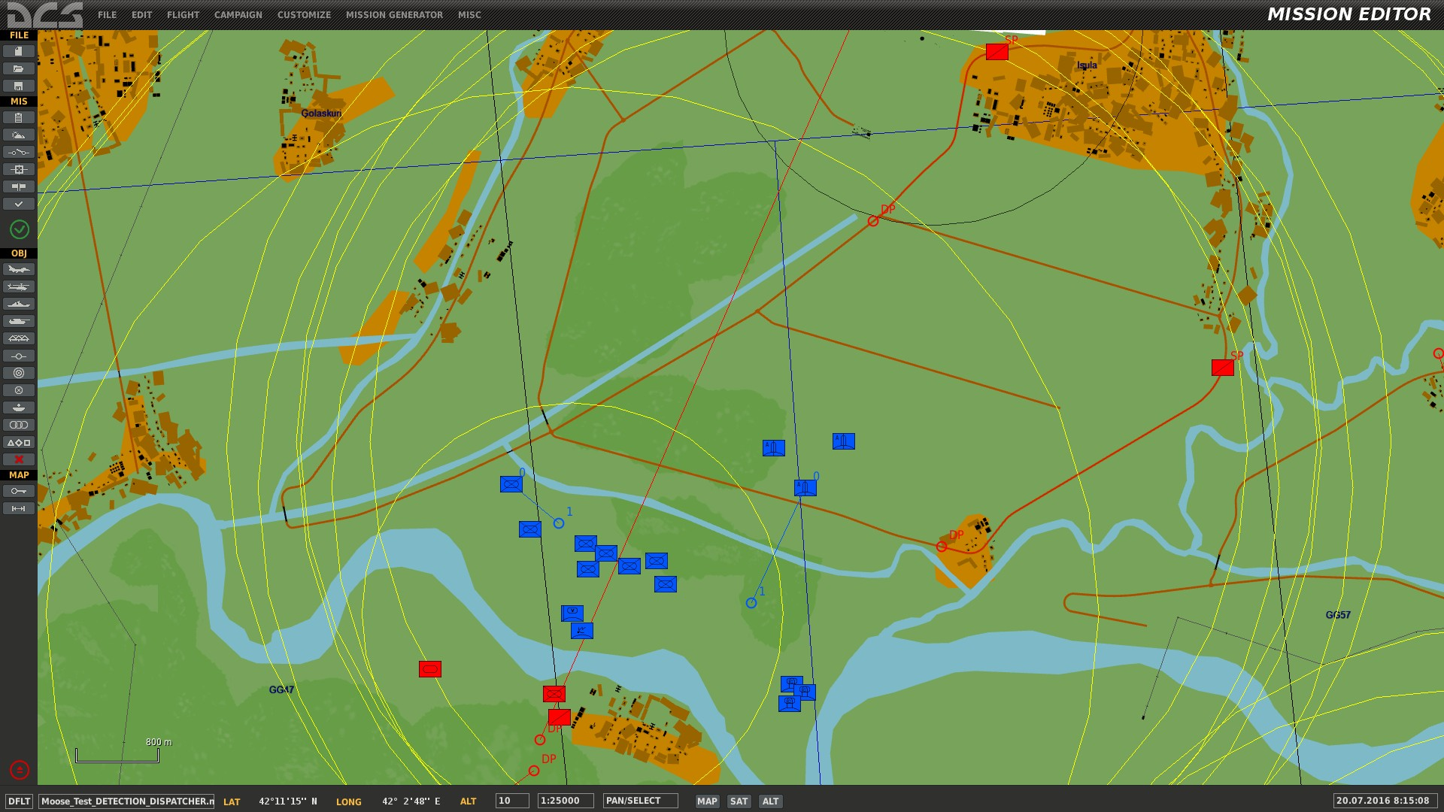
battle scene overview
1
Red ground FACs detecting blue targets
2
Friendlies are nearby the areas.
3
The blue forces are spread out and are of different unit types.
1
3
5
4
There are SAMs with SRs and TRs (HAWKS).
4
5
There are blue SAMs with IR capability.
5

Slide 11
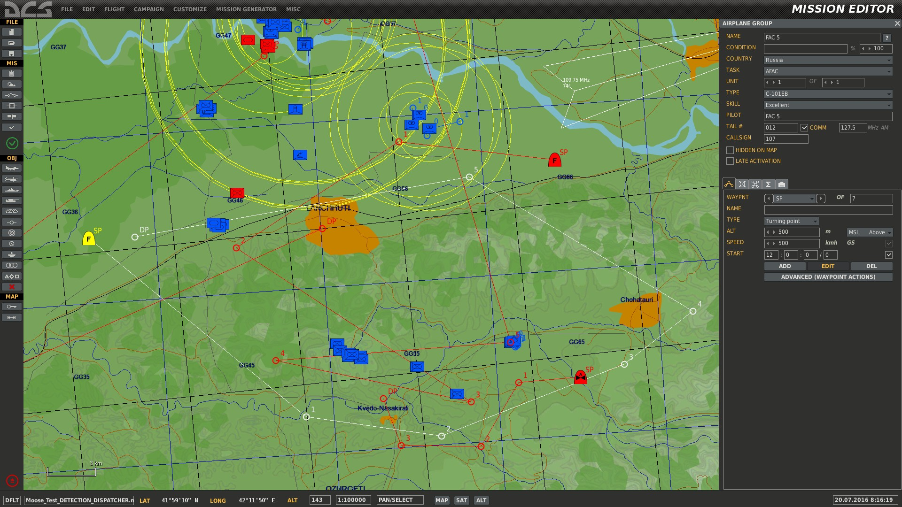
battle scene overview
1
Red airborne AFACs detecting blue targets
2
There are blue forces without friendlies nearby.
2
1

Slide 12
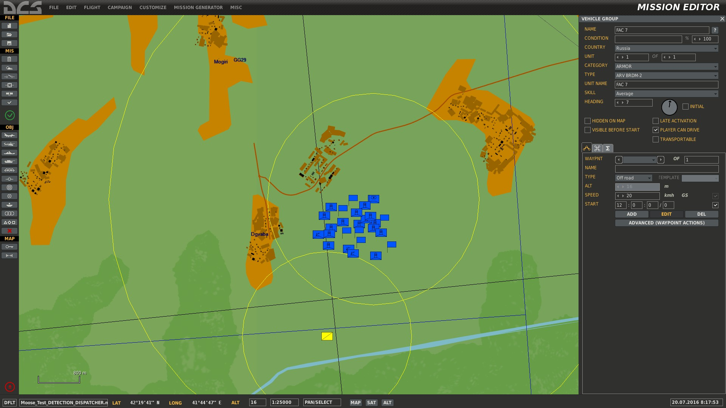
battle scene overview
1
A large PATRIOT battery is located in teh north.
2
A red FAC is detecting the area.
1
2

Slide 13
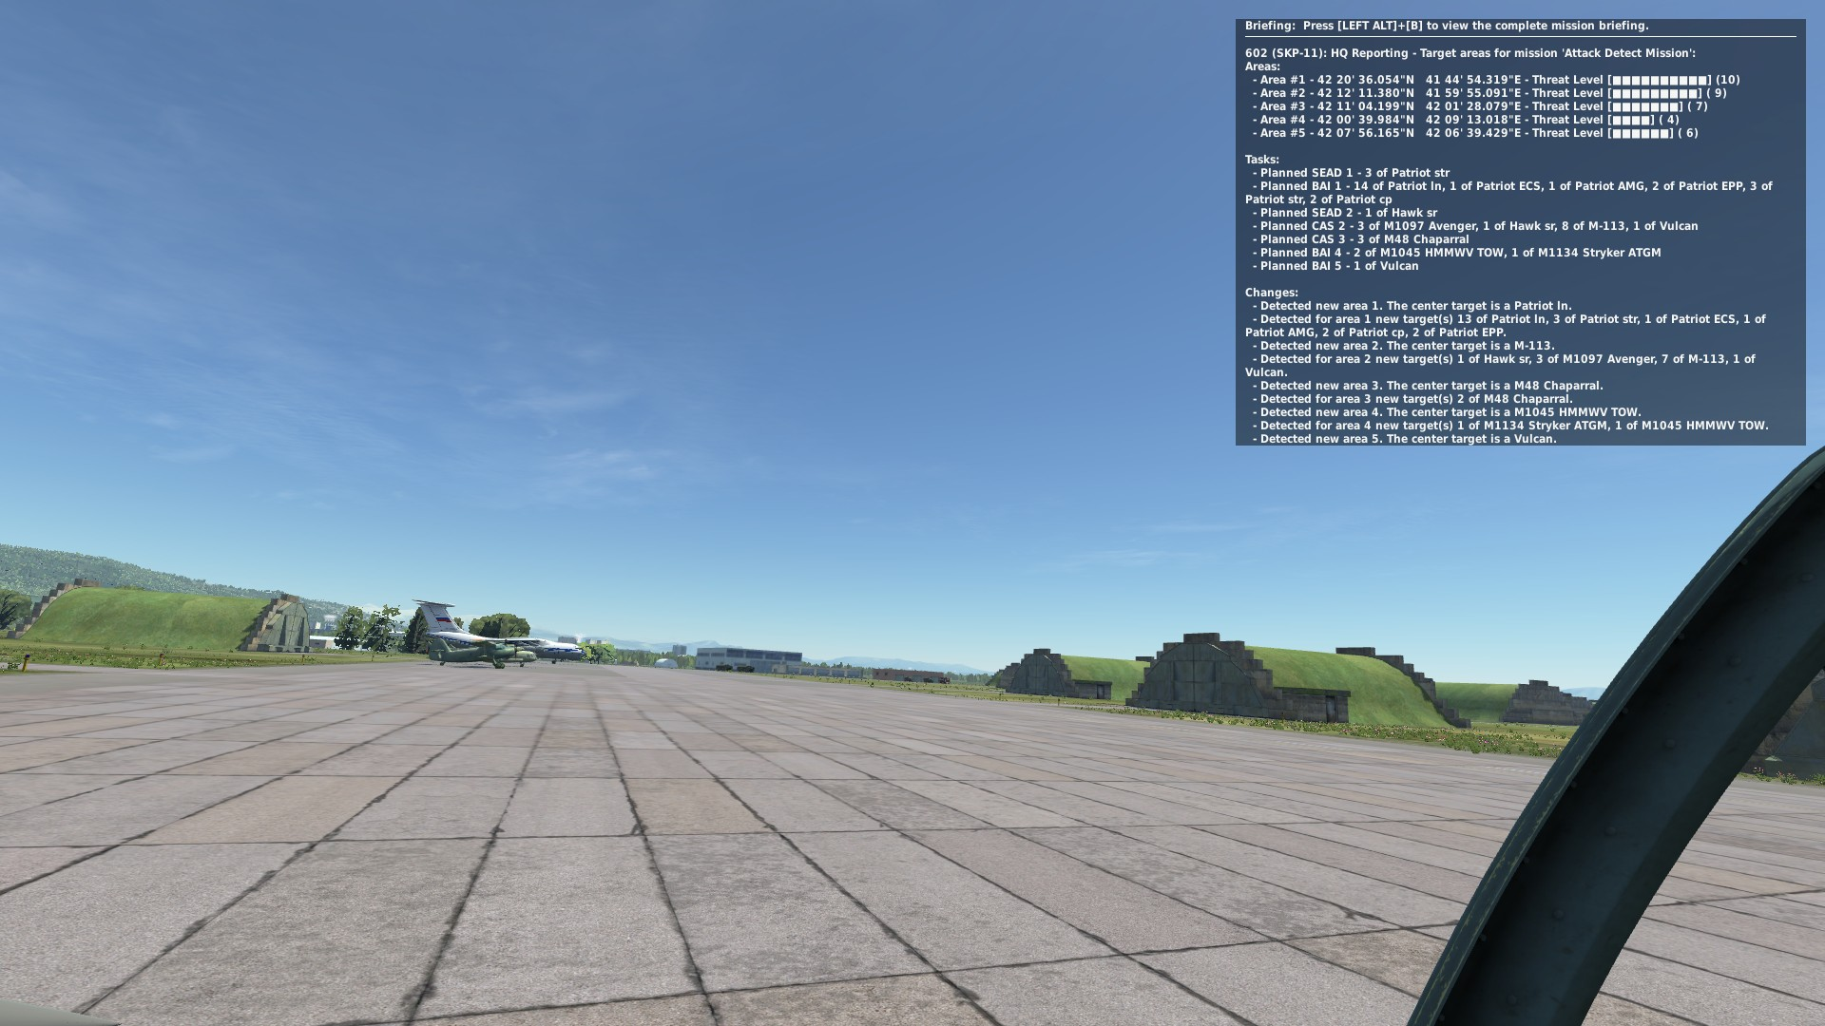
groups will receive taskings from hq
1
The Head Quarters (HQ) reporting tasks
2
We joined GROUP “Attack Theta” in an SU-25T to observe the tasking orders sequence.
1
2

Slide 14
each area is assigned a threat level
10
Long Range SAMs with Search and Tracking Radars.
9
Medium Range SAMs with Search and Tracking Radars.
8
Short Range SAMs with Search and Tracking Radars.
7
Short Range SAMs and MANPADS with Infrared Missiles.
6
Anti Aircraft Artillery
5
Modern Battle Tanks.
4
Battle Tanks and Infantry Vehicles with ATGM.
3
Battle Tanks and Infantry Vehicles without ATGM.
2
Old Tanks and APCs.
1
Infantry.

Slide 15
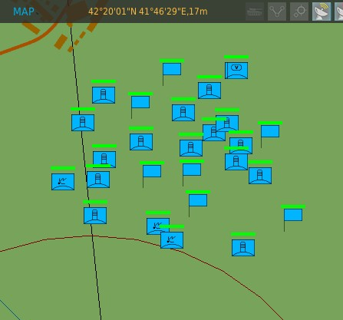
each area is reported coordinates
1
1
Each Area is reported with Latitude and Longitude coordinates

Slide 16
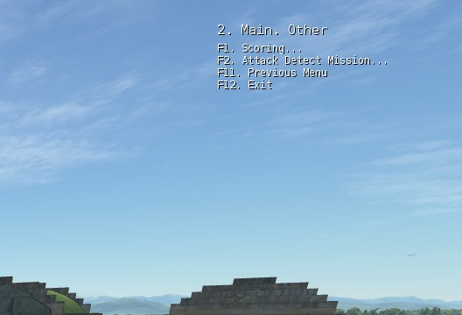
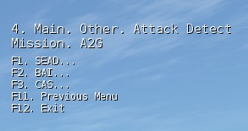
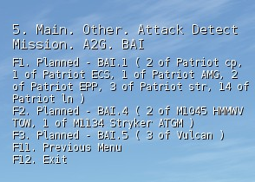
A tasking menu is created at each detection report
1
A new Tasking is created at each detection scan.
4
2
The Tasking Menu is located under “F10. Other” menu items.
3
3
Multiple MISSIONS that mayb be defined, have each their own Tasking Menu.
4
Optionally a SCORING can be added at each MISSION, which will account hits, kills, tasking and mission achievement scores.
5
5
Multiple task types are listed, going through the Menu. After selection of a task type, each task is listed.
6
As the MOOSE framework will evolve, more task types will be added ( CSAR, Transport, JTAC ) …

Slide 17
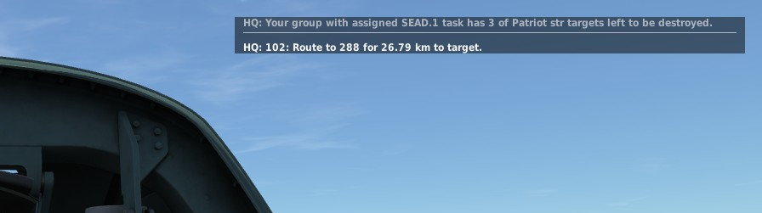
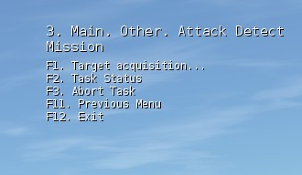
a selected task moves the group in assigned mode…
1
Once a target has been selected, the GROUP you are flying for goes in “ASSIGNED MODE”.
1
2
The tasking menu has changed in assigned mode. Relevant Task Menu options are displayed for the specific Task you selected.
3
2
3
You will receive specific task directions and target goal achievements. Status messages are also displayed.

Slide 18
DEMO

Slide 19
moose for dcs world TAD-210 - A2G Task Dispatching for AREAS and SCORING
a new dynamic
tasking mechanism
in joint development
with the moose
framework
community

Slide 20
moose for dcs world TAD-220 - A2G Task Dispatching for tYPES and SCORING
a new dynamic
tasking mechanism
in joint development
with the moose
framework
community

